Slide 1
End-to-End Training of Deep Visuomotor Policies
Sergey Leviney svlevine@eecs.berkeley.edu
Chelsea Finny cbfinn@eecs.berkeley.edu
Trevor Darrell trevor@eecs.berkeley.edu
Pieter Abbeel pabbeel@eecs.berkeley.edu
Division of Computer Science University of California Berkeley, CA 94720-1776, USA

Slide 2
The related works of Sergey Leviney :
S. Levine and V. Koltun. Guided policy search. In International Conference on Machine Learning (ICML), 2013a.
S. Levine and V. Koltun. Variational policy search via trajectory optimization. In Advances in Neural Information Processing Systems (NIPS), 2013b.
3. S. Levine and V. Koltun. Learning complex neural network policies with trajectory
optimization. In International Conference on Machine Learning (ICML), 2014.
S. Levine and P. Abbeel. Learning neural network policies with guided policy search under unknown dynamics. In Advances in Neural Information Processing Systems (NIPS), 2014.
S. Levine, N. Wagener, and P. Abbeel. Learning contact-rich manipulation skills
with guided policy search. In International Conference on Robotics and
Automation (ICRA), 2015.

Slide 3
The related works by Sergey Leviney :
Paper 1: this paper that introduced the Guided policy search (GPS) algorithm.The policy search is
model-free, it is guided by a model-based DDP algorithm, which generate the guided
samples, and use importance sampling to incorporate the guiding samples.
(ISGPS)
Paper 2: this paper introduced the Variational Guided Policy Search algorithm based on trajectory
optimization.(VGPS)
Paper 3: this paper introduced the Constrained guided policy search algorithm based on trajectory
optimization.(CGPS)
Paper 4: this paper introduced a method to fit the system dynamics with the trajectory’s samples, so that
in the GPS algorithm, the guided algorithm can work model-free.
Paper 5: the above are all execute simulated robotic manipulation tasks. This paper introduced several
improvements to the guided policy search alogrithm in paper 4 to make it more practical for
robotic applications, and successfully run on a real robot.

Slide 4
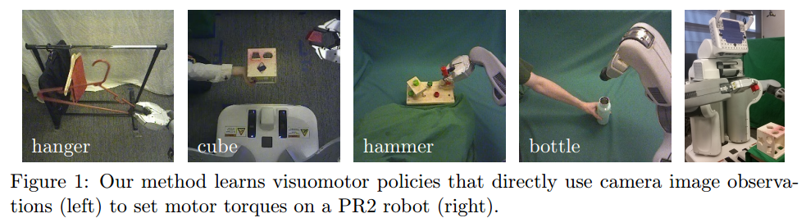
END TO END : using deep neural networks to map image pixels and joint angles to motor torques
The paper’s contribution:
Developing a guided policy search algorithm for sensorimotor deep learning
Developing a novel CNN architecture designed for robotic control
Robot control: 20Hz, images: 240x240, robot joint torques: 7 DoF arm

Slide 5
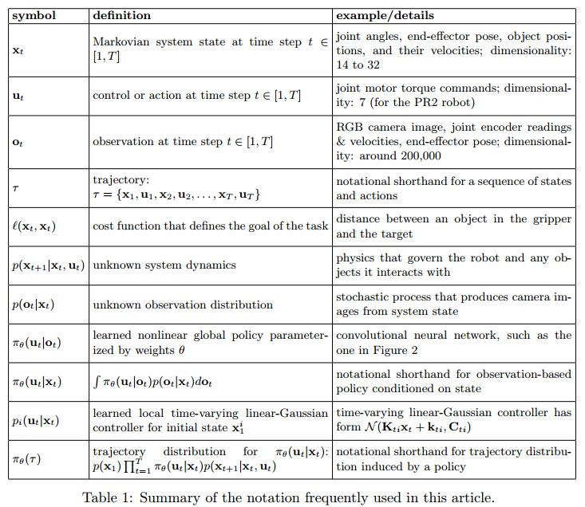

Slide 6
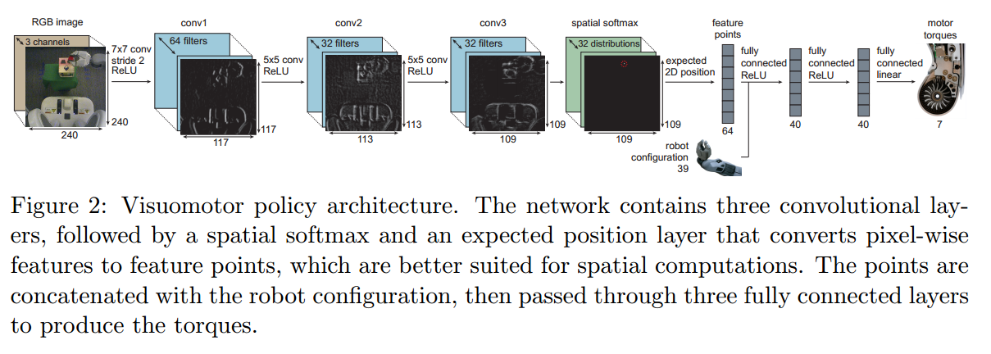
Policy architecture: πθ(ut|ot)
The network has 7 layers and around 92000 parameters, of which 86,000 are in the convolutional layers

Slide 7

spatial softmax and an expected position layer in policy network:
acij = max(0, zcij) for each channel c and each pixel coordinate (i; j)
where (xij, yij) is the image-space position of the point (i, j) in the response map
The effect of the layer:
serve to convert pixel-wise representations in the convolutional layers to spatial coordinate representations, which can be manipulated by the fully connected layers into 3D positions or motor torques
provides lateral inhibition, which suppresses low, erroneous activations, only keeping strong activations that are more likely to be accurate. This makes the policy more robust to distractors, providing generalization to novel visual variation.

Slide 8

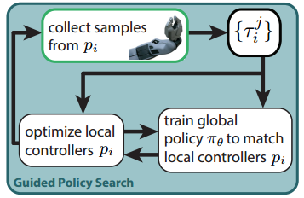
Guided policy search algorithm:
The GPS algorithm separates the problem into separate phases:
1. Supervised learning phases
2. Trajectory learning phases
i: different initial state
Pi: pi(ut | xt), the guiding trajectory distributions
πθ: πθ(ut | ot), the deep visuomotor policie
In supervised learning phases:
use the trajectories generated by all Pi to training
the global policy πθ to fit the guiding distributions Pi
In trajectory learning phases:
pi(ut | xt) is learned local learned local time-
varying linear-Gaussian controller for initial state xi ,
it is optimized with a variant of the iterative linear-
quadratic-Gaussian regulator (iLQG), which is a
variant of DDP (Differential dynamic programming)

Slide 9
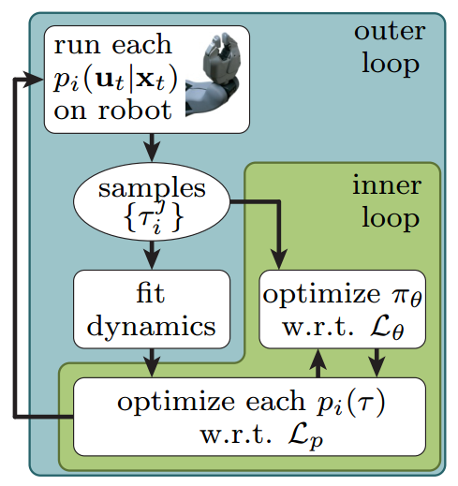
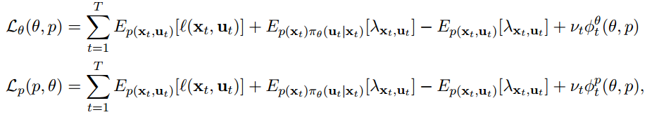
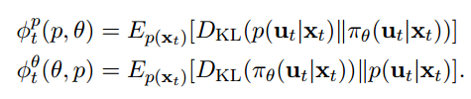
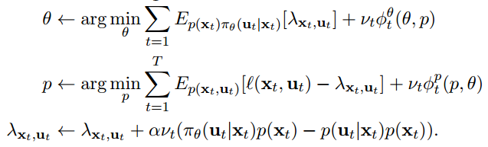
Guided policy search algorithm optimization:
When training, the guiding distributions Pi need the state xt and the system dynamics p(xt+1|xt, ut) since the DDP is a model-based method, but the GPS method is model-free, so the algorithm use the trajectories to fit the system dynamics while training the policy:
The object is a constrained problem :

Slide 10
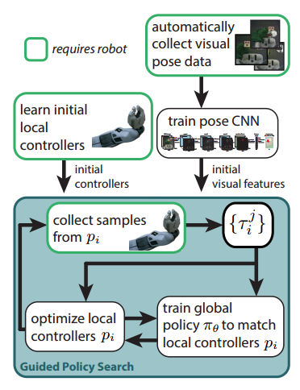
Pre-training: introduce a pretraining scheme that allows to train effective policies with a relatively small number of iterations
1. Initial visual features:
pretrain the convolutional layers of our network by
predicting elements of xt that are not provided in the
observation ot, such as the positions of objects in the
scene.
initialize the first layer filters from the model of
Szegedy et al. (2014), which is trained on ImageNet
(Deng et al., 2009) classification.
2. Initial controllers
initially train the guiding trajectory distributions
pi(ut|xt) independently of the convolutional network
until the trajectories achieve a basic level of
competence at the task, and then switch to full guided
policy search with end-to-end training of πθ(ut|ot)

Slide 11
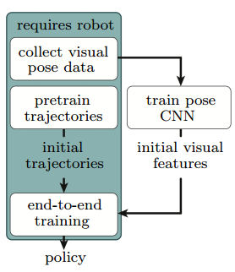
The whole alogrithm:
supplementary video: http://sites.google.com/site/visuomotorpolicy

Slide 12
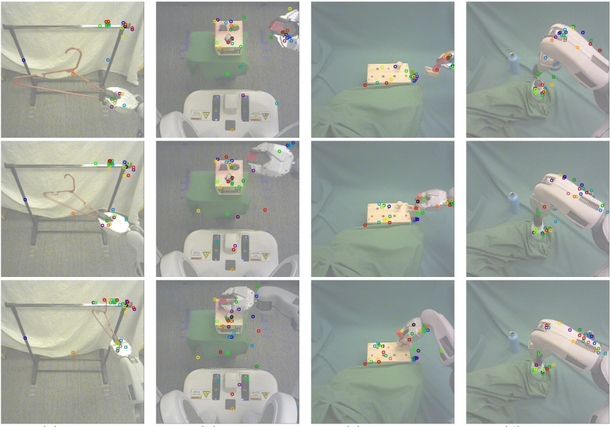
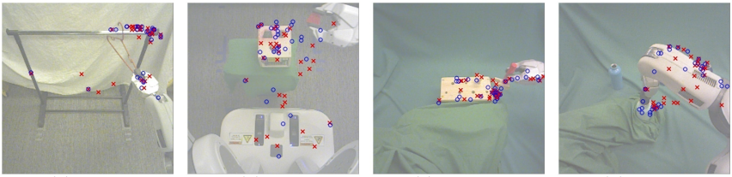
Feature points tracked by the policy during task execution for each of the four tasks. Each feature point is displayed in a different random color, with consistent coloring across images. The policy finds features on the target object and the robot gripper and arm. In the bottle cap task, note that the policy correctly ignores the distractor bottle in the background, even though it was not present during training
Feature points learned for each task. For each input image, the feature points produced by the policy are shown in blue, while the feature points of the pose prediction network are shown in red. The end-to-end trained policy tends to discover more feature points on the target object and the robot arm than the pose prediction network.

Slide 13
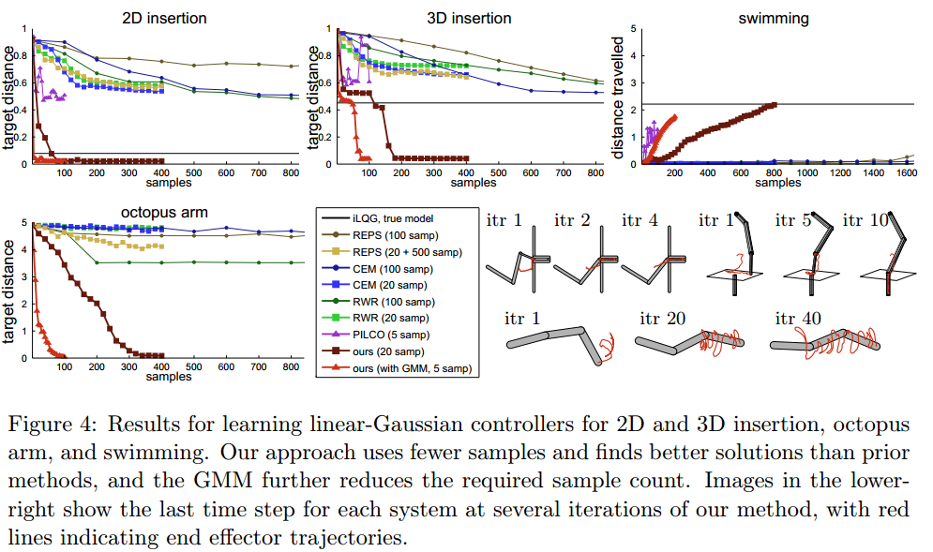

Slide 14
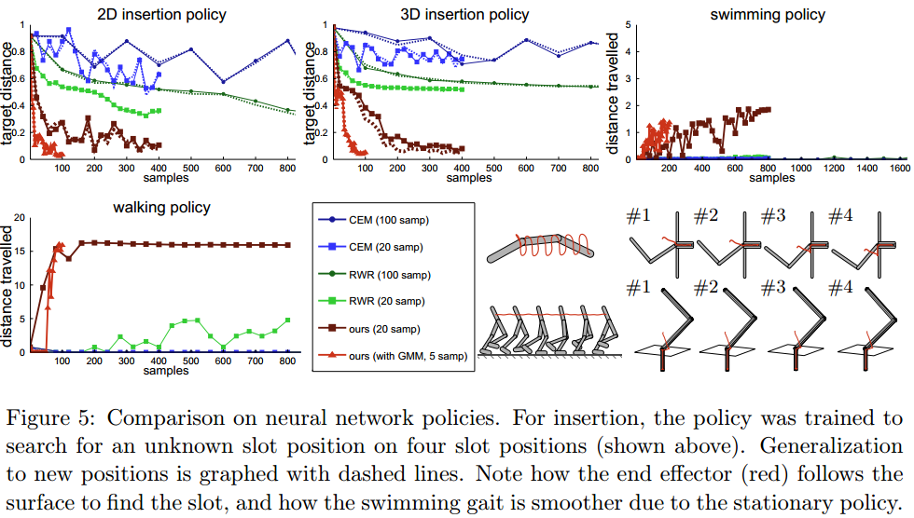

Slide 15
Deep Visual Foresight for Planning Robot Motion
Chelsea Finn and Sergey Levine

Slide 16
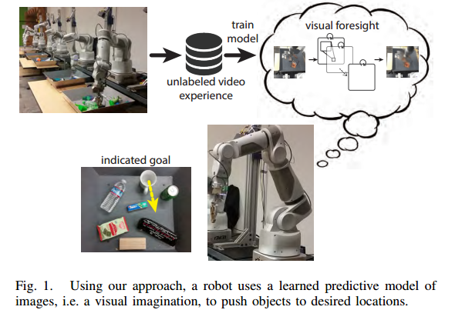
The paper’s work: present an MPC algorithm based on probabilistic inference through a learned predictive image model that allows a robot to plan for actions that move user-specified objects in the environment to user-defined locations.
It is the first instance of robotic manipulation using learned predictive video models with generalization to new, previously unseen objects

Slide 17
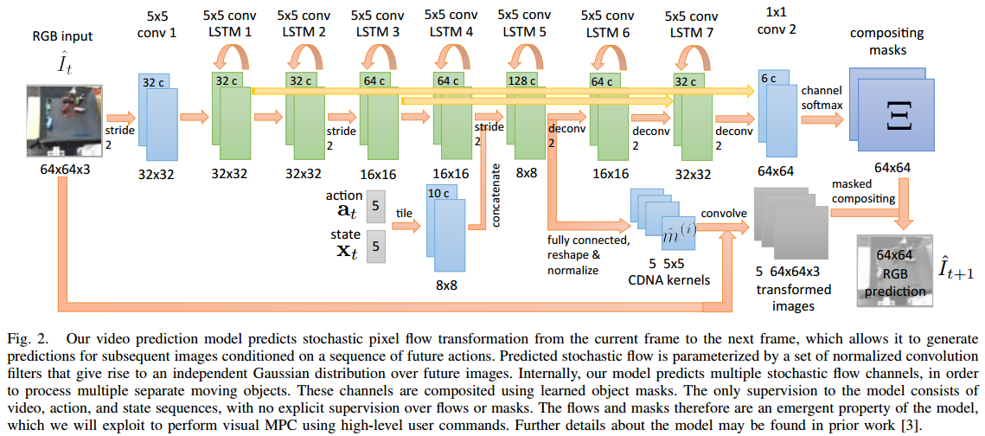
Inputs: I0:1(the current and previous images) + x0:1(current and previous end-effector poses ) + a1:Hp(a sequence of future commands)
Outputs: a distribution over the sequence of future image frames I2:Hp+1

Slide 18



The model is trained with maximum likelihood, which results in a mean squared error objective. We can therefore express the model probabilistically as :
The flow map Fˆt(x;y;k;l) denotes the probability of pixel (k;l) at time t + 1 originating from location (x;y) at time t, and is given by the following :
The model can then output a prediction for the mean of the distribution over the next image, which we denote Iˆt+1, according to the following equation:
For convenience, we will use M(It-1:t;xt-1:t;at:H) = Fˆt:H to denote the function that uses the learned model to output a sequence of flows conditioned on pairs of images and states, as well as a sequence of future actions, for some horizon H. We can therefore define the predicted image distribution as :

Slide 19


Specifying Goals with Pixel Motion:
The user selects one or more desired source pixels in the initial image, which we will denote d0(1);:::;d0(P), with each pixel’s position given by (xd(i), yd(i)), and then specifies a corresponding goal position for each of those pixels, which we will denote g(1);:::;g(P), with each goal position given by (xg(i), yg(i)). With this goal specification, the robot can plan to move the objects for which the selected pixels belong.
Evaluating Actions with Implicit Pixel Advection:
Formally, we construct an initial probability distribution over the designated pixel’s position at the current time step t, which we denote P(st). We assume that the current position of the designated pixel dt = (xd;yd) is known at time t, as it is provided by a user at time t = 0 can be tracked thereafter. Thus, we define the distribution at the current time step t as:
Let Pt+k denote the 2D conditional distribution P(st+k|It-1:t;xt-1:t;at:t+k;dt), we then have:

Slide 20

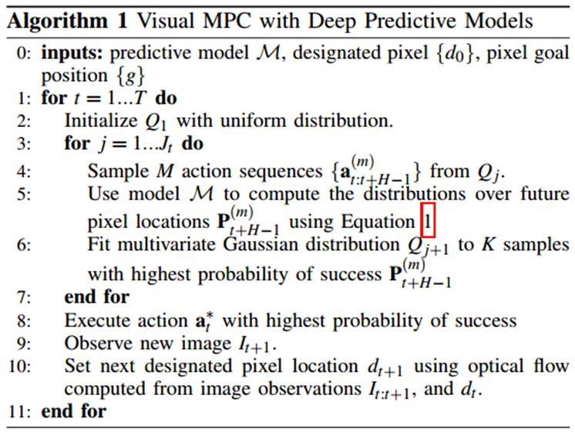
At each time step t, we sample M action sequences of length H, , and compute the probabilities of success for each one, denoted by . We then select the K action sequences with the highest values of , fit a multivariate Gaussian distribution to these K selected action sequence, and resample a new set of M action sequences from this distribution. The new set of action sequences improves on the previous set, and the resampling and refitting process is repeated for Jt iterations. This corresponds to
the CEM stochastic optimization algorithm.
At the end of the last iteration, we take the
sampled action sequence
that is most likely to be successful, and
execute on the robot. We use Jt = 4
iterations, M = 40 samples per iteration,
and K = 10 samples during the initial
planning phase (t = 0) and, when
replanning in real-time (t > 0), we take Jt =
1 iteration of M = 20 samples, performing
just one round of sampling. Note that each
batch of M samples corresponds to a
forward pass through deep recurrent
network with a batch size of M, and
therefore can be parallelized very
efficiently

Slide 21
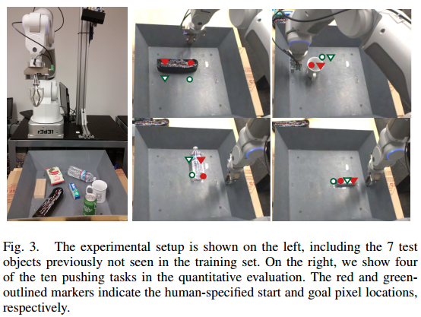
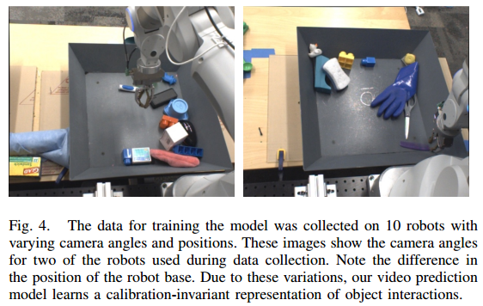
See https://sites.google.com/site/robotforesight/

